Slide 1

Class action and employment discrimination
Walmart Stores, Inc. v. Dukes
Speaker：祝文君，刘昱麟，丁晨怡，邹煜阳

Slide 2
CONTENTS
1.Background
2. 8 steps
3.Class action and employment discrimination
4.Related case

Slide 3
01
PART
Background
Plaintiff: six women, including Dukes
Defendant: Walmart

Slide 4

Background
- In 2000, Betty Dukes and five other women filed a class-action lawsuit against Walmart, alleging gender discrimination in pay and promotion.
- In June 2001, the lawsuit began in the United States District Court in San Francisco.
- The lawsuit sought to represent 1.6 million women who had worked at Walmart stores since Dec. 26, 1998.

Slide 5
Background
- Walmart appealed a federal district court's ruling in favor of class proof, arguing that the class did not satisfy the requirements for a class action.
- The Supreme Court agreed to hear Walmart's appeal on December 6, 2009.
- On June 20, 2011, the Supreme Court ruled in favor of Walmart, stating that the plaintiffs did not have enough in common to constitute a class action.
- The court ruled unanimously on the lack of commonality and by a 5-4 majority that the case could not proceed as a class action.

Slide 6
02
PART
8 steps

Slide 7
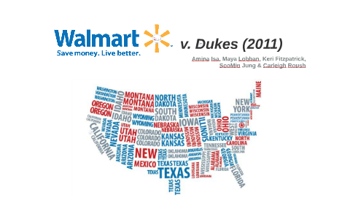
8 steps
1. Facts of the case (claims and reasons of both parties):
The plaintiffs accused Walmart of gender discrimination in its pay and promotion policies and practices, while the defendants claimed that the company's pay and promotion policies were fair and equitable, and the plaintiffs pointed to only individual cases.

Slide 8
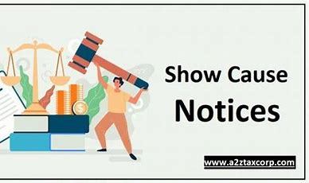
8 steps
2. Is employment discrimination a common problem in the company rather than an isolated case and Whether the class action requirements have been met.

Slide 9

8 steps
3. What are the reasons and conclusions?
Conclusion: The plaintiff does not meet the requirements of the class action "there are common issues of law or fact, including the plaintiff's claim to represent the other members and the plaintiff adequately represents the interests of the class", so the class action is not established.
Reason: The judge determined that for a class action to be established, there must be a common problem of law or fact among the class members. In this case, the plaintiff alleged a violation of Title VII, which can be violated in different ways. Employees from the same company who claim Title VII injuries, even if they are different, do not automatically have actionable commonalities. Therefore, the class action is not valid.

Slide 10

8 steps
4. What are the relevant legal rules?
Title VII of the Civil Rights Act
Eeoc,446 u.s.318,330 (1980)
Karen Gullo; Cronin Fisk, Margaret (February 14, 2009).
Dukes v. Wal-Mart Stores, Inc., 509 F.3d 1168(9, 2007).

Slide 11
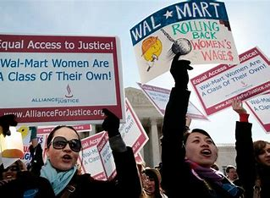
8 steps
5. Does the legal argument contain clear ambiguity?
Exists. It's vague. Based on the facts of this case, the conceptual gap between an individual's claim of discrimination and "the existence of a class of persons suffering the same harm" must be bridged by "meaningful evidence" that the employer is operating under a general discrimination policy, and there is no such evidence here.

Slide 12

8 steps
6. Code of ethics
Justice: Merriam-Webster. The court evaluated whether Walmart's alleged pay and promotion gaps violated the principles of fair and equal treatment, which are fundamental in employment law.

Slide 13

8 steps
7. Are legal analogies appropriate?
The key difference between an individual's claim of discrimination and a class-action lawsuit alleging a general pattern or practice of discrimination is clear. Investigations about individual claims are the cause of a particular employment decision, and in the liability phase of a pattern or practice trial, the focus will usually not be on individual hiring decisions, but rather on discriminatory decision-making patterns.

Slide 14
03
PART
Class action and employment discrimination

Slide 15
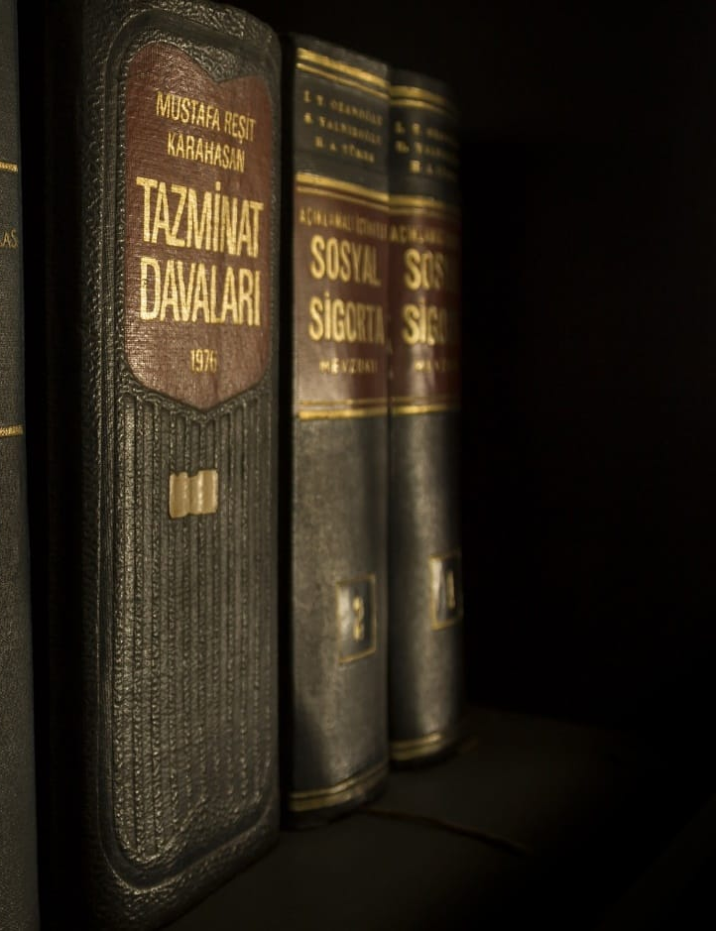
Definition
1. Definition:
Class action: A class action lawsuit is a legal process that allows a group of people to jointly Sue the same defendant or group of defendants.
Discrimination: Employment discrimination is any adverse conduct or differential treatment in the workplace that results in an unfair or disadvantageous situation for certain individuals or groups.

Slide 16

Class action
2. analysis of Class action
First, certification is a prerequisite for class action lawsuits:
(1)The class is so large that the consolidation of all claims is impractical;
(2) There are common problems between the classes;
(3) Appointing the plaintiff's claim to represent the claims of other members of the class;
(4) The appointed plaintiff will adequately represent the interests of the class.

Slide 17

Employment discrimination
3. Analysis of employment discrimination
The Walmart case involved a class action lawsuit filed by female employees alleging pay and promotion discrimination. They claimed that local managers favored men, resulting in unequal treatment for women. The plaintiffs presented personal experiences and evidence of significant disparities in pay and promotions between male and female employees at Walmart. They also highlighted the subjective decision-making process of local managers, leading to inconsistent practices across locations. Walmart's decentralized management approach made it difficult to implement standardized policies and ensure equal opportunities for all employees, resulting in discrimination within the company

Slide 18
04
PART
Related case

Slide 19

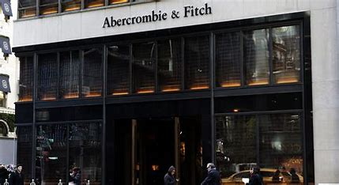
Gonzalez v. Abercrombie & Fitch Stores, Inc.
Plaintiff: Latino, African American, Asian American, female applicants and employees
Defendant: Abercrombie & Fitch Stores, Inc.

Slide 20
Related case
Background:
In 2003, many women and Latinos and Asian-Americans who are discriminated filed a class action lawsuit against Abercrombie & Fitch for violating Title VII of the Civil Rights Act of 1964 by excluding minorities and women and other policies, which limited their employment. After the cautious trial, the court ruled in favor of the plaintiff.

Slide 21
Related case——Employment Discrimination
Restrictive Marketing image Recruitment and Employment Practices
The plaintiffs argued that the company's hiring and employment practices excluded them, despite their qualifications, and steered them into lower-status positions instead of front-office sales roles.
These practices suggested that the company may have been making decisions based on gender and race, violating Title VII of the Civil Rights Act.

Slide 22
Related case
This case involved many female and minority employees and alleged that the company's hiring, employment practices and marketing image violated the Civil Rights Act.
The fact met the three of criteria for a class action :
1. Large number
2. Common legal question
3. Common interests

Slide 23
Related case
4. Identical claim for compensation:
In April 2005, U.S. District court approved a settlement worth about $50 million that required retail apparel giant Abercrombie & Fitch to provide monetary benefits to Latino, African American, Asian American, female applicants and employees who accused the company of discrimination. The settlement, rendered as a Consent Decree, also requires the company to institute a range of policies and programs to promote diversity among its workforce and to prevent discrimination based on race or gender.
Unlike the previous case, the plaintiffs in this case met the four requirements for a class action. Therefore, this case can be judged as a class action lawsuit.

Slide 24
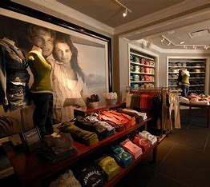
Summary
Malala Yousafzai, who was awarded Nobel Peace Prize said “I raise up my voice, not so I can shout, but so that those without a voice can be heard.” That’s also the meaning of class actions that present employment discrimination or other issues to public, guaranteeing more people’s legitimate rights and interests.

Slide 25
Thanks for listening!
Group 18:祝文君，刘昱麟，丁晨怡，邹煜阳, 时若凯，朱晨阳，朱天圆，黄蕾，吕佳励

